Slide 1


ArtEcho
Pratik Patil, Stephanie Mortel, Yilin Liu, Dongjing Li
Notes:
Hello and welcome to our presentation on our app called ArtEcho.
I'm [name]x4

Slide 2
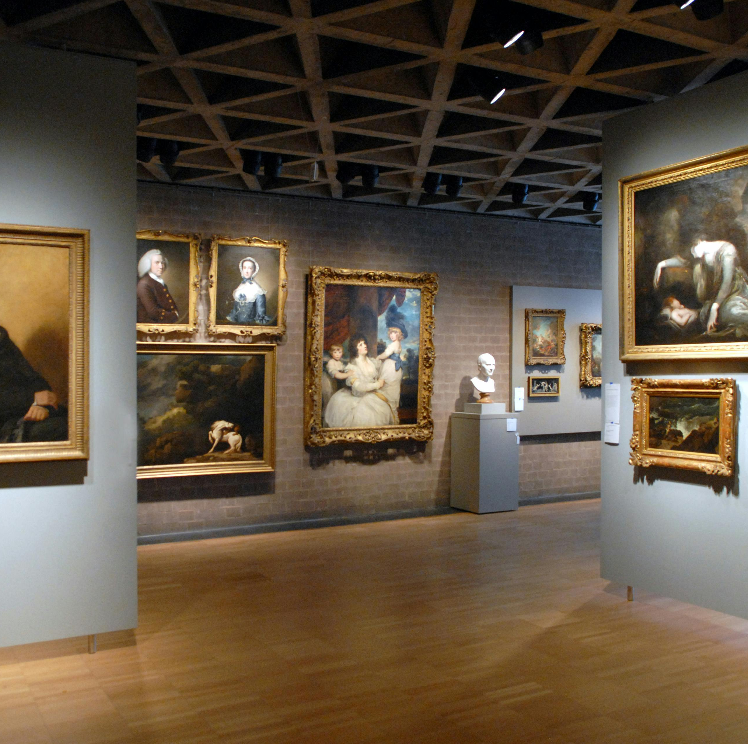
What Does it Do?
An app that helps people understand paintings and sculptures in museums using a large-language model (LLM)
Takes a photo as an input and then outputs an LLM-generated informative/meaningful description of the art piece
Notes:
ArtEcho is an app that helps people understand art pieces like paintings and sculptures you would commonly find in a museum.
It takes a photo as input and then outputs an LLM-generated description of the art piece.

Slide 3
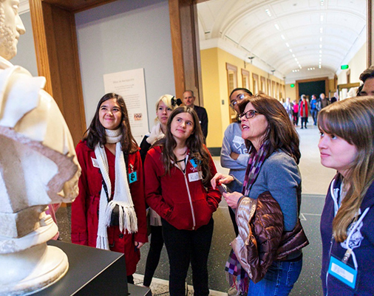
Target Audience
Main focus is to help parents explain art to their kids
Or help anyone who wants to learn about art
This Photo by Unknown author is licensed under CC BY.
Notes:
The app is intended to be used for educational purposes, from parents trying to teach their kids about art to laypeople who want to learn more.

Slide 4
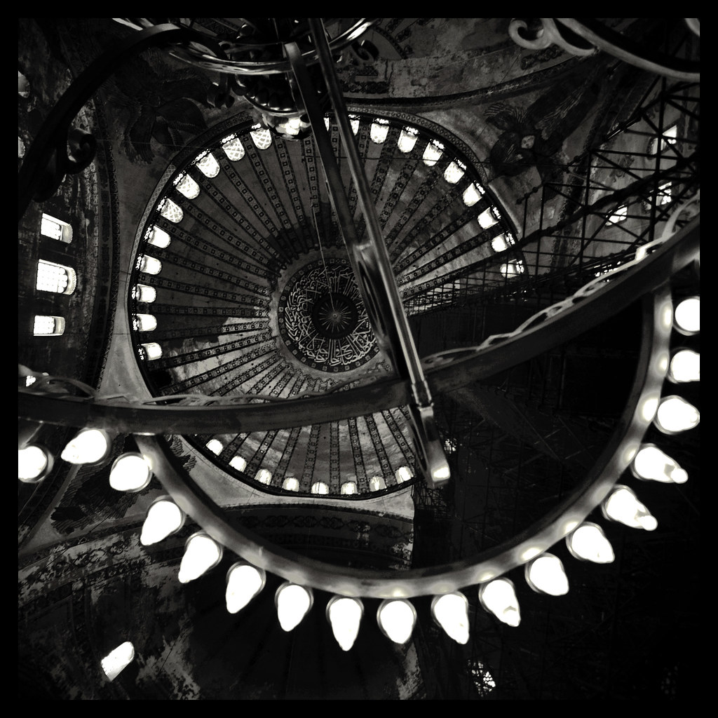
Significance
The name "ArtEcho" suggests reflection or reverberation of art's essence, history, and stories back to the audience. It captures the app's mission to not just present art but to echo its deeper meanings, contexts, and narratives to the user. This name emphasizes the interactive and resonant nature of the app, where each piece of art or cultural artifact echoes through time to reach and educate the viewer.
Notes:
The point of an app like this is to help those who would otherwise find art boring to dig deeper and engage with art on a level that would be more meaningful to them.

Slide 5
Initial Plans vs. Implementation
Over time, we consolidated some of our initial planned views so that UI became more intuitive
We decided to forgo a profile page because we did not want to store more personal info about the user than was necessary
Notes:
Your initial plans. Were you able to complete building all the functionalities? If not, what are the functionalities that you could not build? Why?

Slide 6
Future Development Goals
Add feature for user to add their own API key for the LLM
Switch data storage from Firebase to local so their data is not shared on internet
Have a standard default prompt so the user does not necessarily need to write one themselves
Notes:
Describe the future goal of development. (future features, unfinished functionalities, etc.)

Slide 7
App Walkthrough
Notes:
Worth 20 points

Slide 8
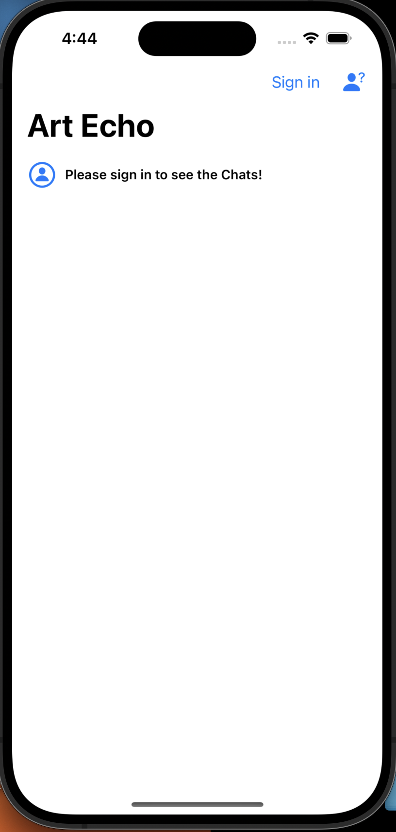
Home Screen: Default
Serves as entry point to the app
User needs to login or register to use app
Click "Sign in"
Notes:
Explain layout/features of home screen

Slide 9
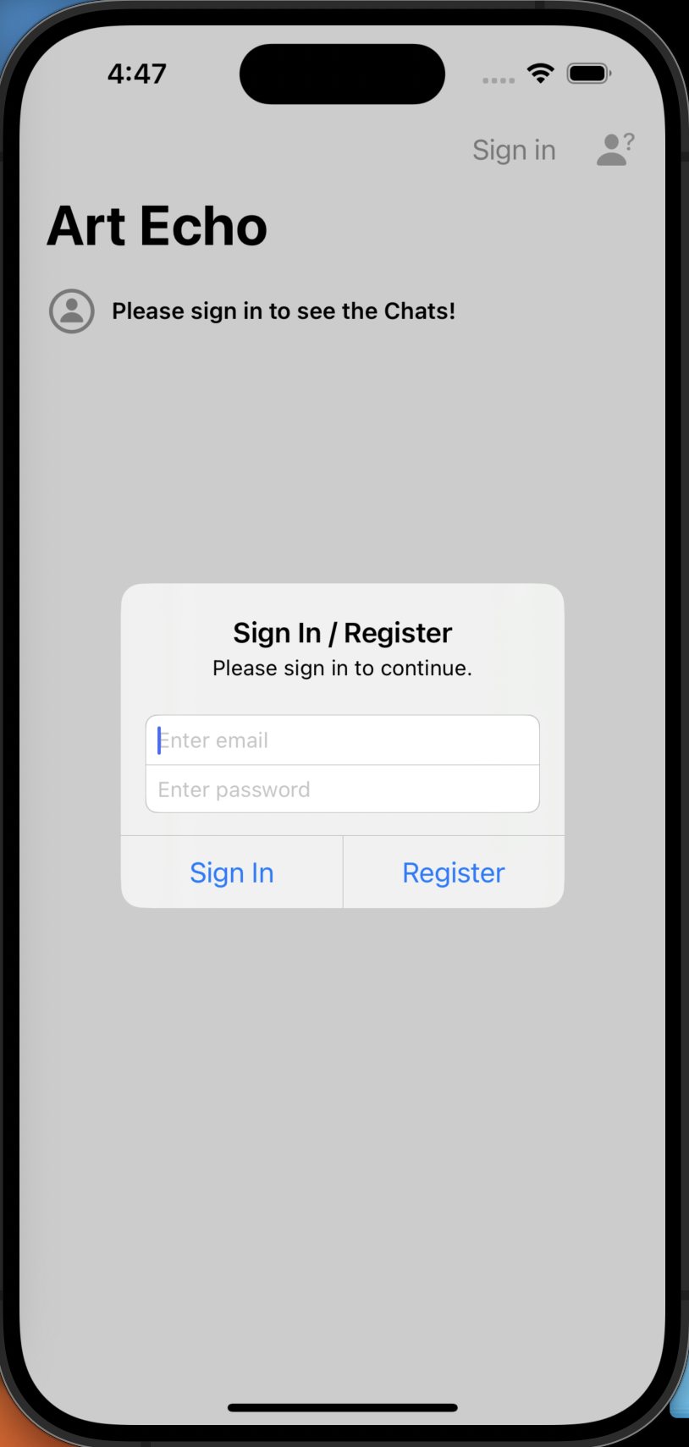
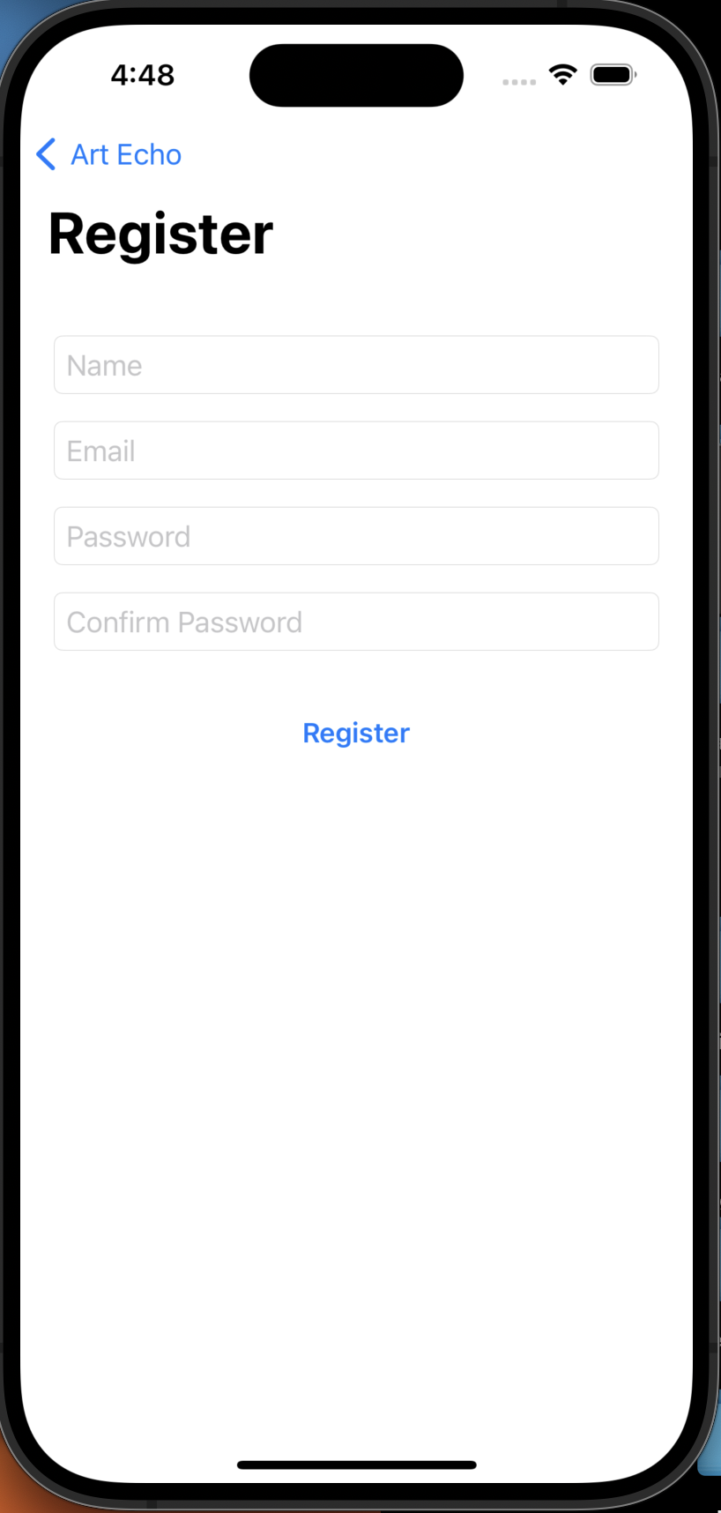
Login or Register
Enter user credentials to login into or register an account
User data stored in and login authenticated by Firebase
Notes:
Explain how to login or register

Slide 10
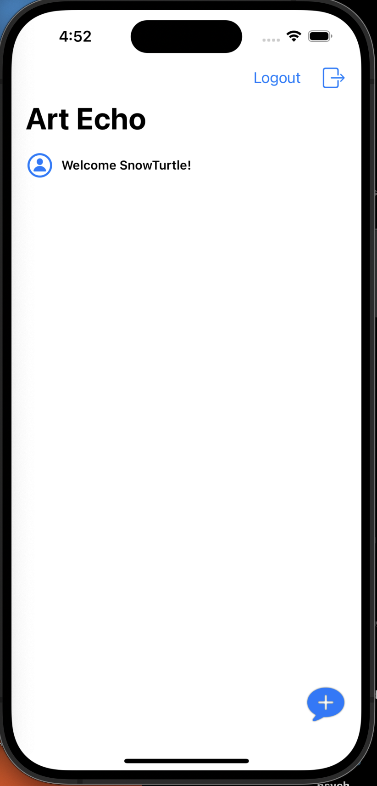
Home Screen: Logged In
New users will have no saved descriptions
Existing users will see list of saved descriptions
Add button: allows user to generate new art descriptions
Notes:
Explain layout/features of home screen

Slide 11
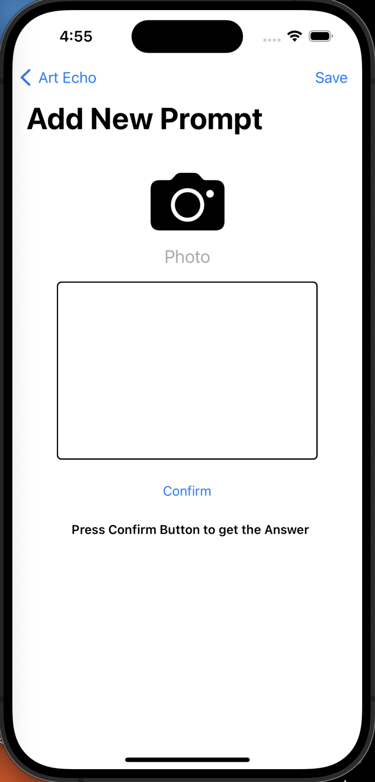
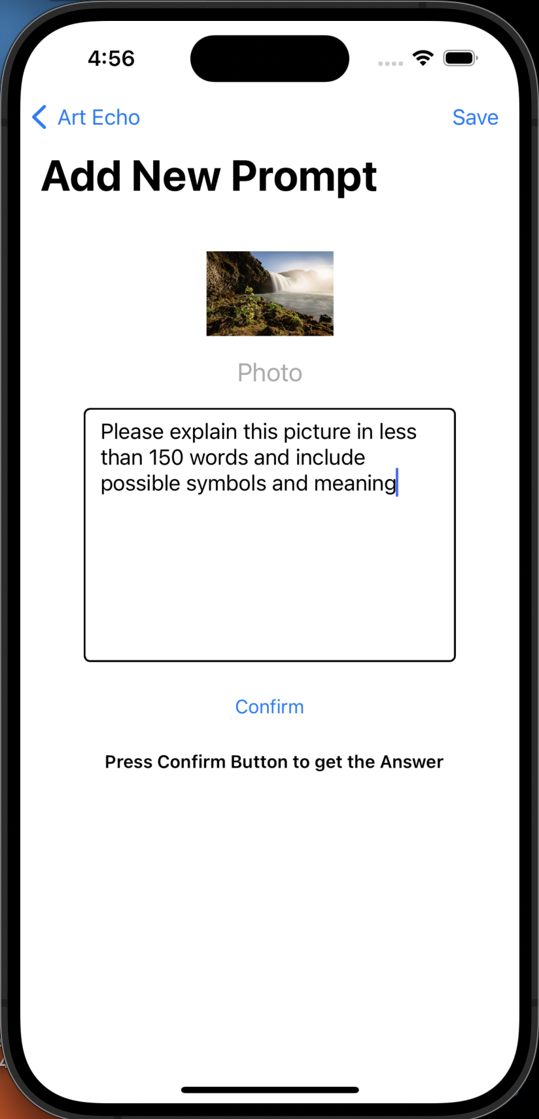
Photo and Prompt Input
User can take photo using the camera or select a pre-recorded photo
User enters a prompt to generate relevant info they are interested in
Confirm button: prompts app to generate a relevant response to the inputs via Gemini Vision Pro 1.0 API

Slide 12
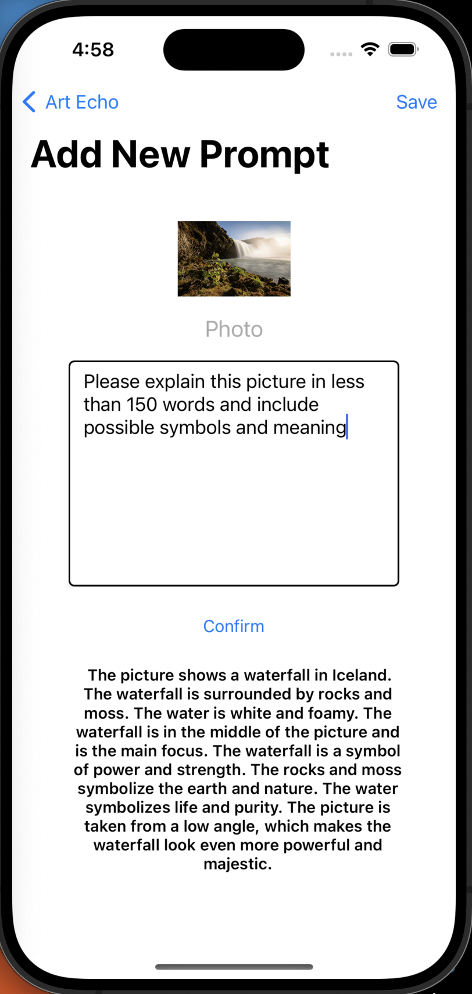
Art Description Output
App may take time to load the generated description
User reads generated output and has option to:
Generate new output by giving new/modified inputs
Save the description
Go back to the home screen

Slide 13
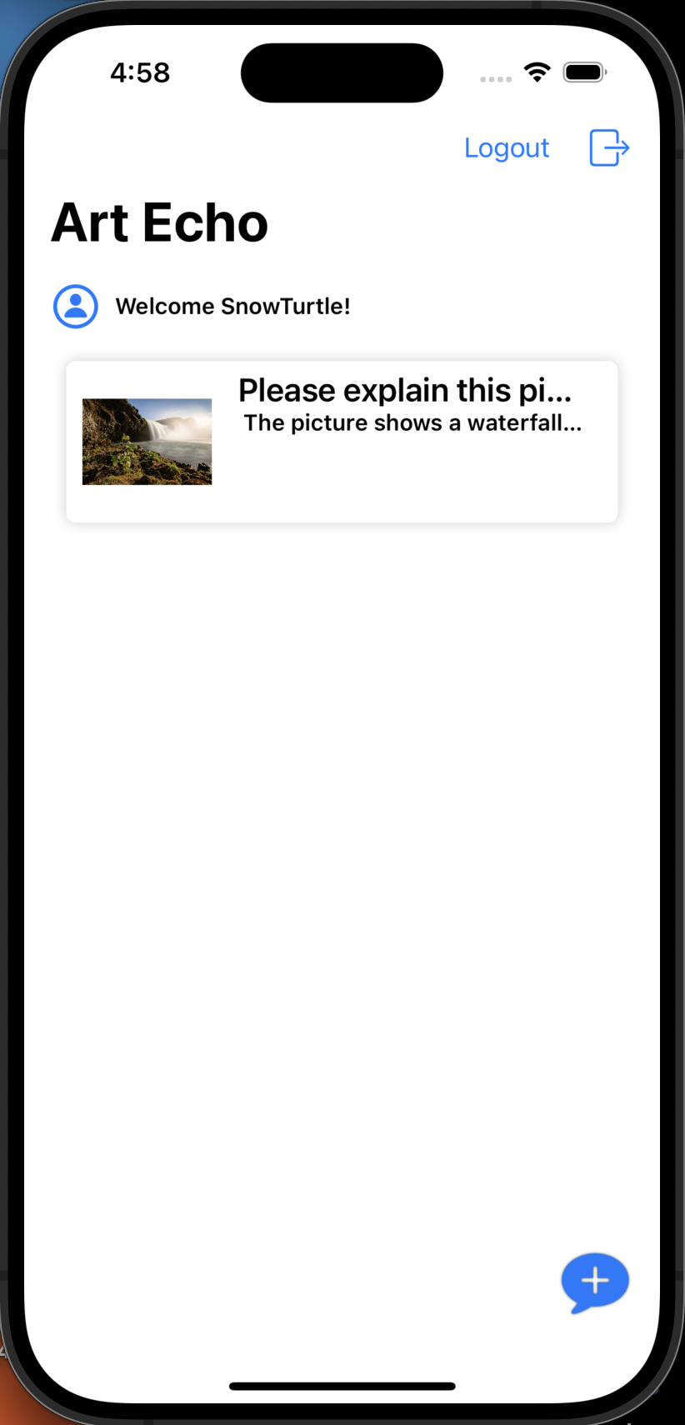
Home Screen: Updated Favorites
Favorite art descriptions can be saved in the app, done using Firebase in the backend
List of saved favorites will be displayed on user's home screen

Slide 14
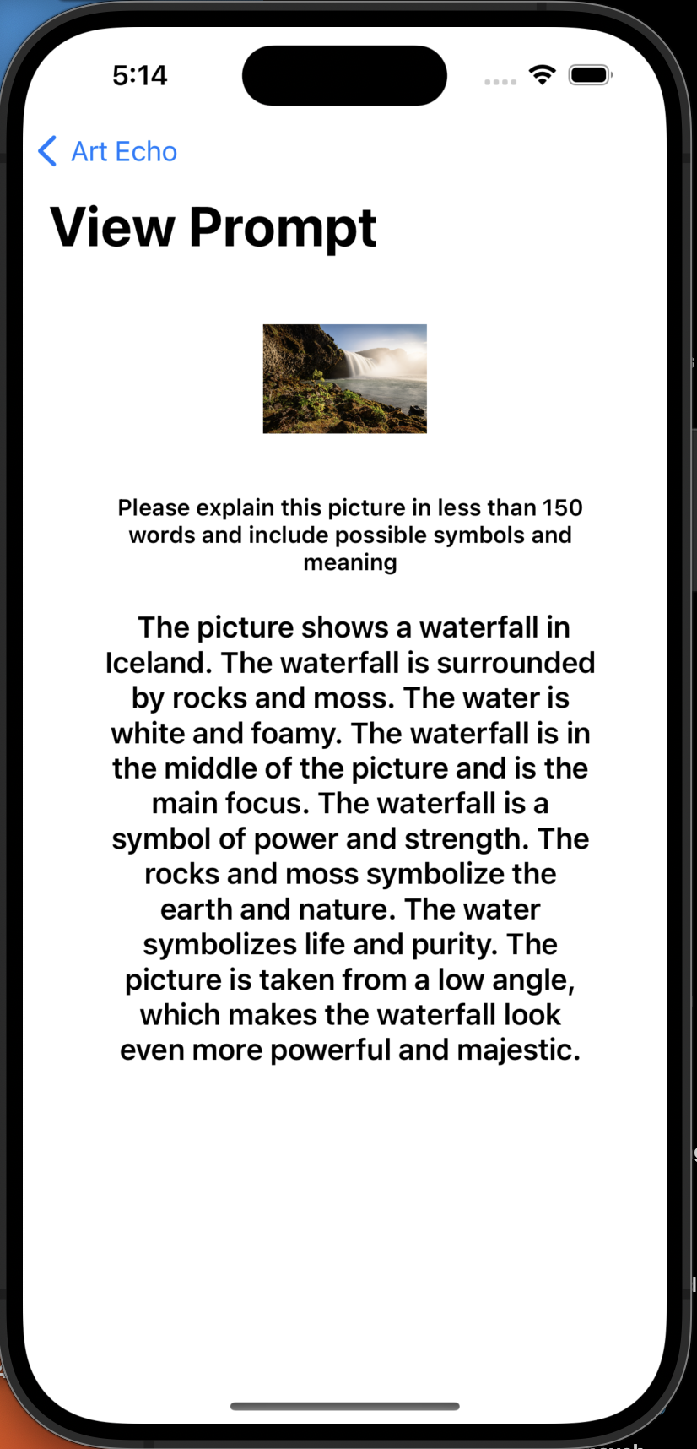
View Info
User can click on a previously saved description to view the info

Slide 15
Lessons from Building this App
How pricing for LLM API works (Gemini Vision Pro 1.0)
How to cache an image using a third-party library (SDWebImage)
How to implement loading icon for buffering time (UIActivityIndicatorView)
Notes:
What are things that you've learned from building the app?
Any specific difficulty that you had?

Slide 16
Overall Reflections
We spent a lot of time on the design and subsequent iterations
We also spent a lot of time researching and learning how to use the API and libraries required for the app
Due to this, development time was reduced from what we initially expected
Overall, fun learning experience, especially with learning how to use Gemini API

Slide 17
GitHub Repository
https://github.com/curiouspratik/ArtEcho.git

Slide 18
Thank You!

